Slide 1
Hosting and Domain NAmes
Yukiko Ishida

Slide 2
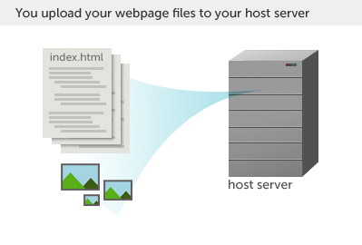
We live here!
Notes:
A website is simply a collection of files that live on a web server- a physical computer that stores and servers up your files.

Slide 3
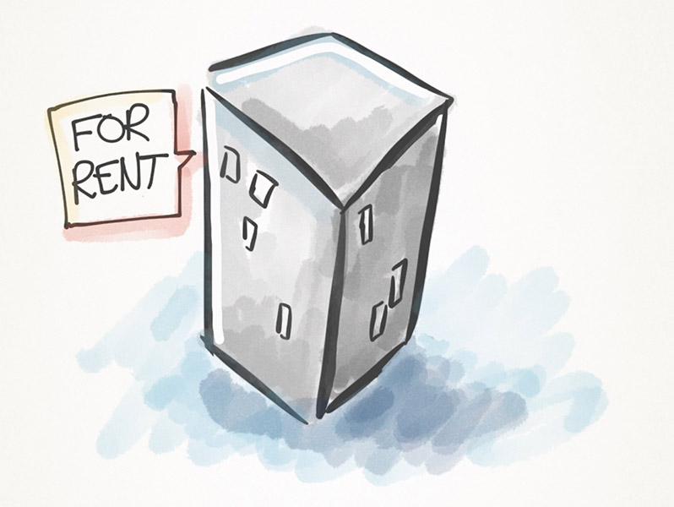
Hosting rent space on a server
Notes:
Most students rent shared space on a server. Big sites have many servers all to themselves.

Slide 4
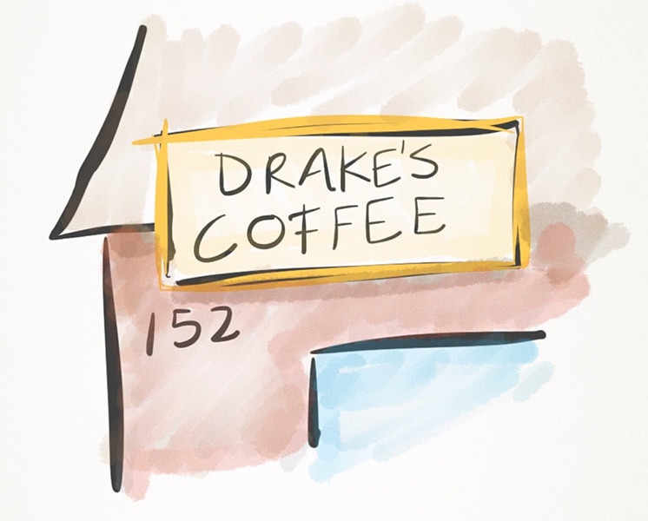
Domain name Purchase a big sign

Slide 5
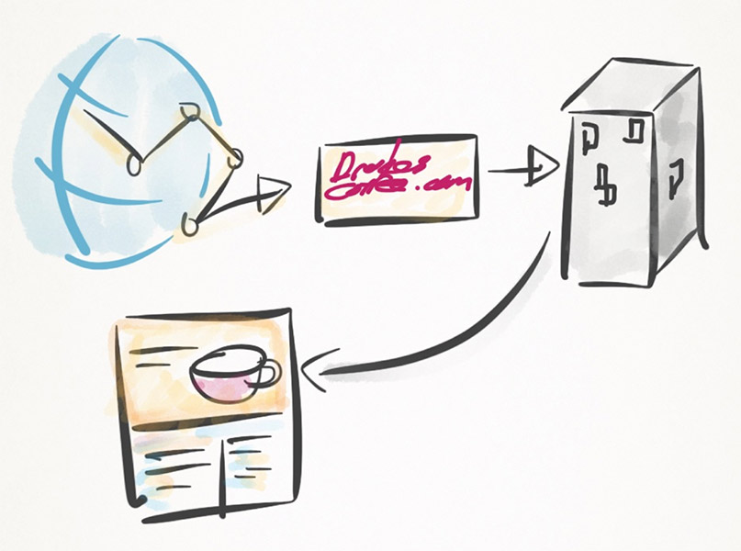
Notes:
When people try to access your site on the internet, they type in your domain name. That big sign points to the hosting server which stores your files. The server then serves up the site back to the user.

Slide 6
Shopping tips

Slide 7
Purchase Hosting + Domain Name
Already have them? OK to reuse

Slide 8
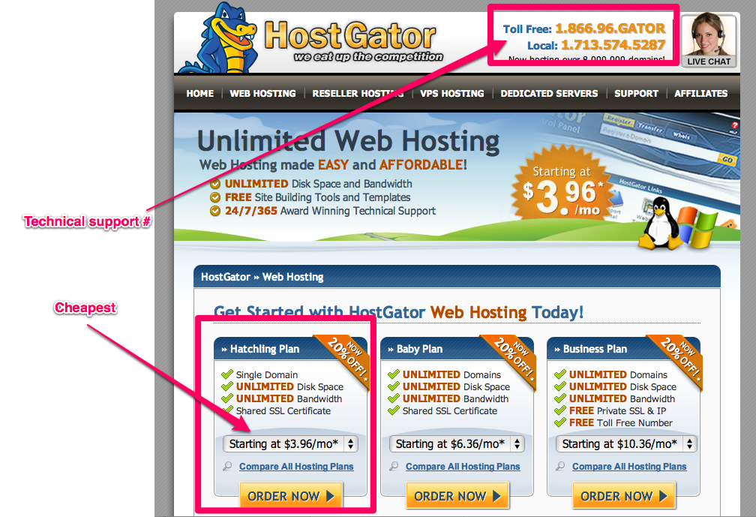

Slide 9
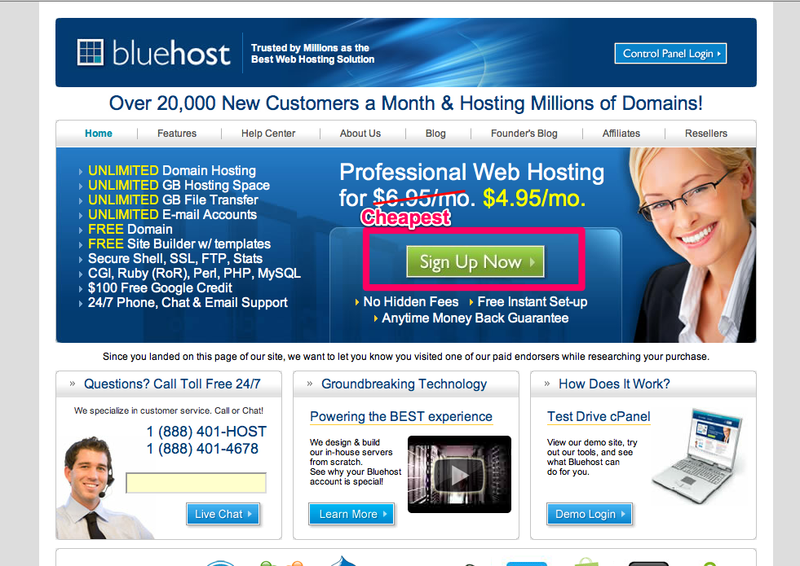

Slide 10
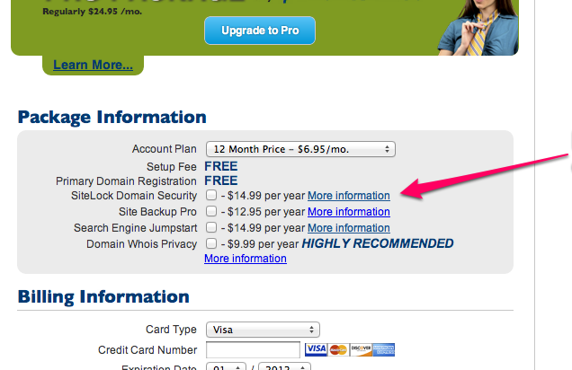

Slide 11
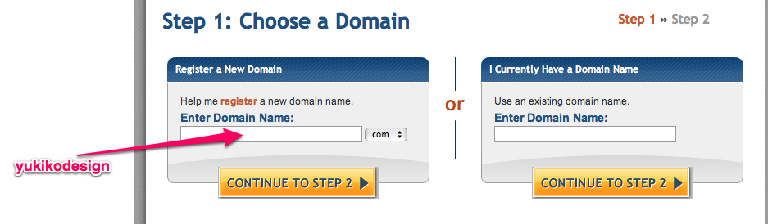
Notes:
When you register a domain name, you should make sure you pick professional, easy to spell, easy to remember names

Slide 12
Shopping Tips
24/7 Customer support phone #
Under $10 per month
Length of contract (min. class duration)
Domain name included?
Domain name ~$10-15/yr
No extras

Slide 13
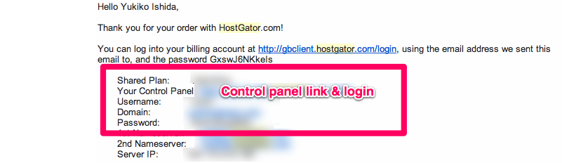
Control panel links

Slide 14
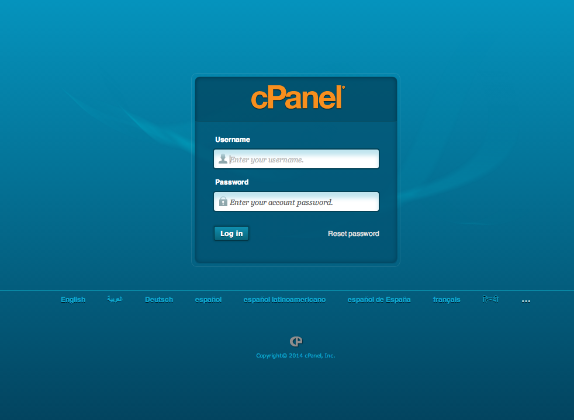
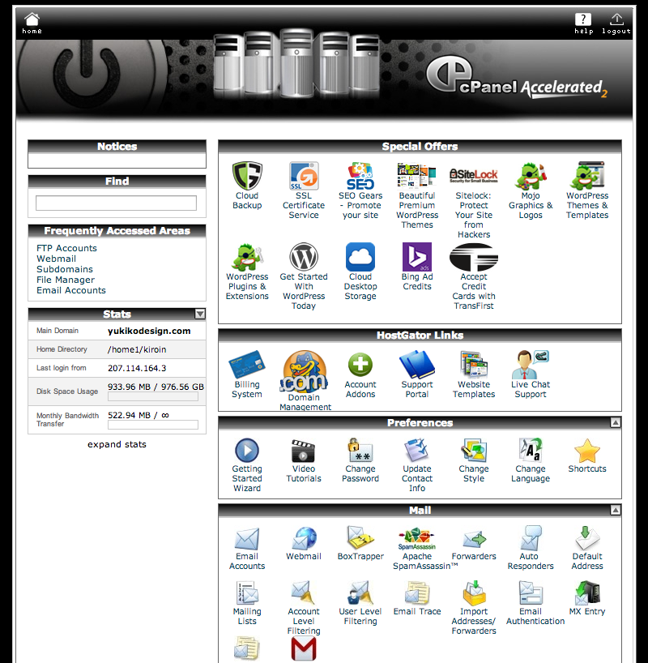
Test your login!
Hosting control panel login

Slide 15
Before Next class
Purchase hosting
Purchase domain name
Login to your control panel (bring login info to class)

